Slide 1
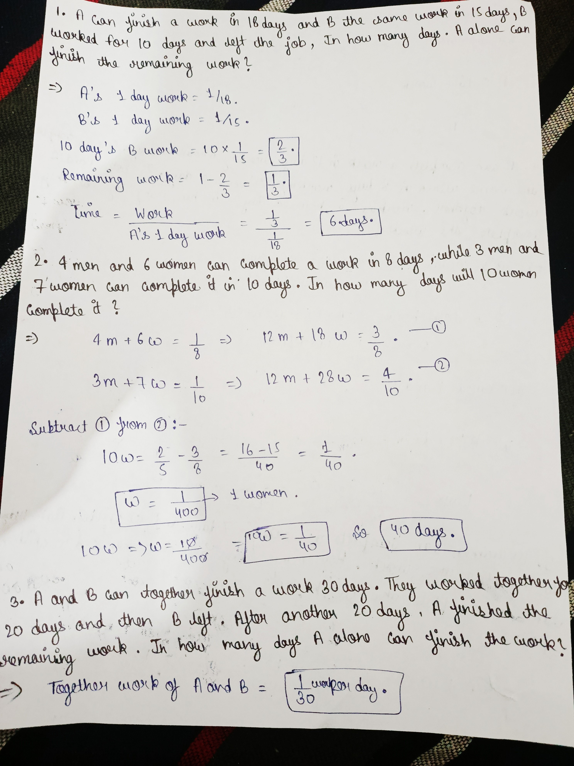
Mukesh Prajapati
202410101230007
B.tech(CS)

Slide 2
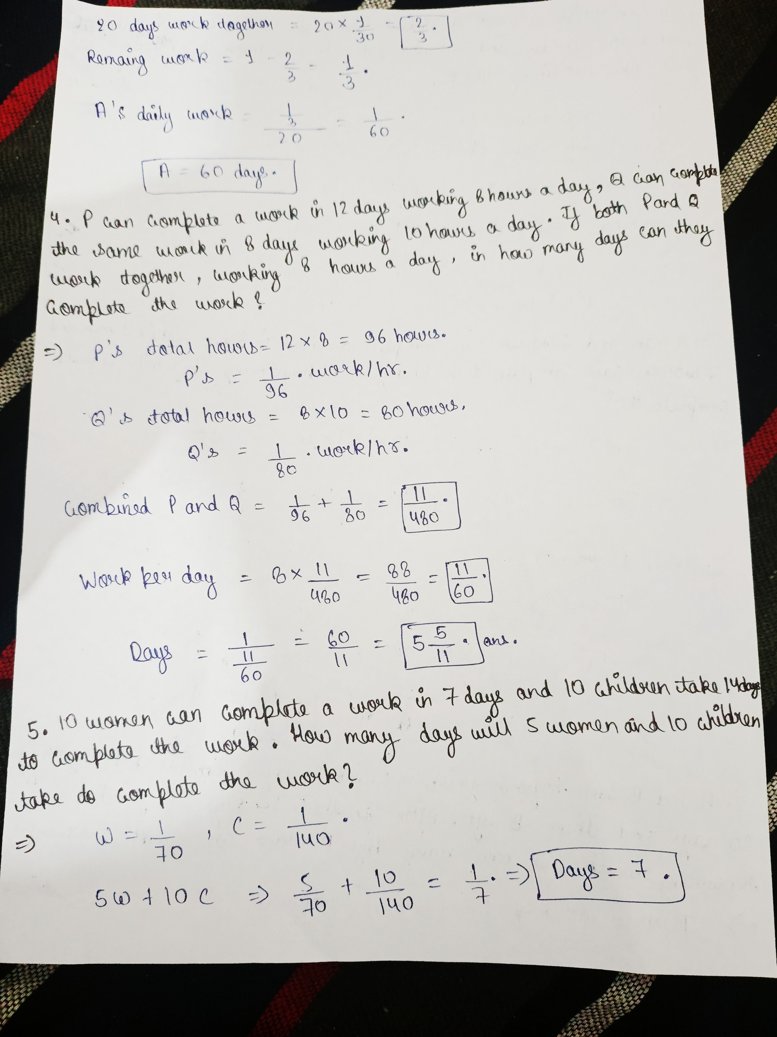

Slide 3
